Slide 1
Combinatorics
3/15 and 3/29

Slide 2
6.1 Counting
A restaurant offers the following menu:
Main Course | Vegetables | Beverage
Beef | Potatoes | Milk
Ham | Green Beans | Coffee
If you must choose 1 main course, 1 vegetable, and 1 beverage, in how many ways can you order a meal?

Slide 3
The Multiplication Principle:
If a process can be broken down into two steps, performed in order, with n₁ ways of completing the first step and n₂ ways of completing the second step after the first step is completed, then there are n₁•n₂ ways of completing the process.
More generally, if a process can be understood as a sequence of k steps performed in order, with n_{i} the possible number of ways of completing the i-th step after the first i-1 steps have been completed, then the number of ways of completing the process is the product n₁ • n₂ • • • n_{k}.

Slide 4
Example
How many 3-digit positive integers are there?

Slide 5
Permutations
In how many ways can six students line up to go outside for recess?

Slide 6
Permutations
The number of permutations of n distinct objects is given by n!=n •(n-1) • • •2 •1.

Slide 7
Permutations
How many three digit numbers are there if you cannot use a number more that once?

Slide 8
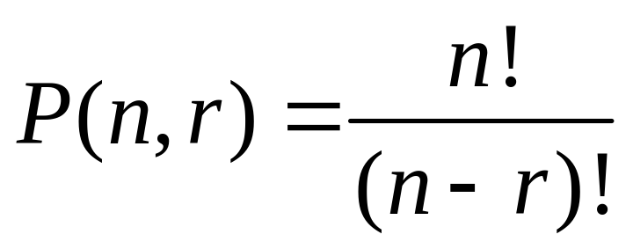
P(n,r)
The number of ways a subset of r elements can be chosen from a set of n elements is given by

Slide 9
The Addition Principle
Suppose that {X₁, X₂, , X_{k}} is a collection of disjoint sets, where X_{i} has n_{i} elements for each integer i, 1<=i<=k. If a process is completed by choosing one element from exactly one of the sets in this collection, then the number of ways to complete the process is the sum n₁+n₂+···+n_{k}.
A die is tossed, and a chip is drawn from a box containing three chips numbered 1, 2, and 3. How many possible outcomes can be obtained from this experiment? Verify your answer with a tree diagram.

Slide 10
Example 1
A die is tossed, and a chip is drawn from a box containing three chips numbered 1, 2, and 3. How many possible outcomes can be obtained from this experiment? Verify your answer with a tree diagram.

Slide 11
Example 2
A password needs to start with 2 letters then 4 numbers. How many passwords are there?

Slide 12
6.2 Combinatorics
What happens if the order of the permutation is not important?

Slide 13
Example
There are 25 students in a class.
  In how many ways can four students be selected to be in an assembly?

Slide 14
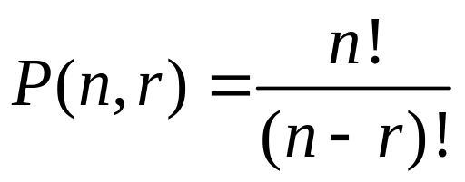
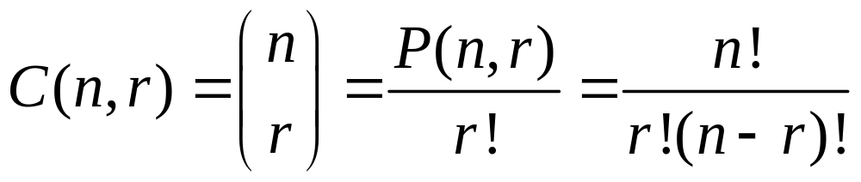
Formula for C(n,r)
The number of r permutations of a set of n elements is denoted by
If order is not important, then for any choice of r objects, there are r! different arrangements. So

Slide 15
Examples
C(6,3)
C(4,4)
C(5,0)
C(4,1)

Slide 16
Example
Let S be a set of 7 elements. How many subsets of S are there that contain
  No elements, 1 element, 2 elements, etc.?

Slide 17
Poker
How many different poker hands can be dealt?
How many of those hands are flushes?
How many of those hands have a three of a kind?

Slide 18
6.3 Pascal’s Triangle
1
1
1
1
2
1
1
3
3
1
1
4
6
4
1
How does Pascal’s triangle relate to combinations?

Slide 19
Conjecture and Proof

Slide 20
Binomial Coefficients
What is (x+y)^{n}?
Conjecture and Proof.

Slide 21
6.4 Permutations and Combinations with Repetitions
How many distinct arrangements are there of the letters in the word MISSISSIPPI?

Slide 22
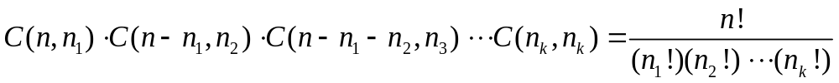
Theorem
Suppose we have n objects of k different types, with n_{k} identical objects of the kth type. Then the number of distinct arrangements of those n objects is equal to

Slide 23
Example
Find the coefficients of (x+y+z)⁵.

Slide 24
Permutations with non-adjacency conditions
Suppose there are 15 students in a class, with 10 of them boys. If we do not want to have two girls next to each other in line, how many different options do we have?

Slide 25
Theorem
If n and k are positive integers, with kn+1, then the number of distinct arrangements of n boys and k girls with no two consecutive girls is C(n+1,k).

Slide 26
6.5 The Pigeonhole Principle
If m pigeons fly into n pigeonholes, where m>n, then there must be at least one pigeonhole containing more than one pigeon.
Musical Chairs

Slide 27
Pigeonholes in Geometry
Show that if 7 points are chosen on or inside a regular hexagon with edges of length 5 cm, then there must be two points within 5 cm of each other.

Slide 28
Example
A baseball player had at least one hit in each of 34 consecutive games. Over those 34 games, he had a total of 52 hits. Show that there was some period of consecutive games in which he had exactly 15 hits.

Slide 29
6.6 The Inclusion-Exclusion Principle
Find the number of positive integers less than or equal to 100 that are multiples of
  5
  6
  8

Slide 30
Example ctd.
Find the number of positive integers less than or equal to 100 that are multiples of
  Both 5 and 8
  Either 5 or 8
  Both 6 and 8
  Either 6 or 8

Slide 31
Example ctd.
Find the number of positive integers less than or equal to 100 that are multiples of
  5, 6, and 8
  Either 5, 6, or 8

Slide 32
Inclusion-Exclusion Principle
If X₁, X₂, …, X_{n} are finite sets, then the size of their union is equal to the sum of the sizes of all intersections of an odd number of those sets minus the sum of the sizes of all intersections of an even number of those sets.

Slide 33
Homework
Homework #10
  6.1 Exercises (15, 16, 18)
  6.2 Exercises (2, 6, 7)
  6.3 Exercises (8, 12, 15)
Homework #11
  6.4 Exercises (4, 6, 11)
  6.5 Exercises (4, 6, 8, 12, 14)
  6.6 Exploratory (2)
  6.6 Exercises (6, 7, 10, 11)

